Slide 1
SEASONAL AGRICULTURE PERFORMANCE INTELLIGENCE
AICTE Student id : STU6a69e81ac4abc1785325594
Name : Mohamed Rifath A
College : Pondicherry University
VOIS DIY MAJOR PROJECT

Slide 2


PROBLEM STATEMENT
Agricultural activities are influenced by seasonal variations in environmental conditions, farming practices, resource availability and market conditions. As a result, agricultural performance may differ from one season to another.
However, raw agricultural data does not clearly explain how agricultural performance changes across seasons or what patterns can be observed in different seasonal conditions.
The problem is to analyze the given agricultural dataset and investigate seasonal differences in agricultural performance by identifying meaningful patterns, trends, relationships and variations within the available data.

Slide 3
Project Description
Analyse agricultural data across different seasons, regions and farming conditions.
Examine variations in crop production and agricultural performance across seasons.
Study the influence of environmental conditions, soil characteristics and farming practices.
Compare resource usage, economic outcomes and agricultural performance across seasonal conditions.
Identify meaningful patterns, trends and relationships to support evidence-based agricultural planning.
Performance Insights: Generate data-driven insights to understand agricultural performance and support better seasonal planning and decision-making.

Slide 4

Objectives
Data Cleaning & Preparation: Prepare accurate and consistent agricultural data for analysis.
Seasonal Performance Analysis: Compare agricultural performance across different seasons.
Crop-wise Analysis: Analyse differences in yield, production and profitability across crops.
Environmental & Soil Analysis: Study the relationship of environmental and soil conditions with agricultural outcomes.
Resource & Irrigation Analysis: Examine fertilizer, pesticide, irrigation, water usage and water efficiency.
Economic & Risk Analysis: Compare revenue, cost, profit and disease/pest risk across relevant groups.
Insights & Recommendations: Identify meaningful patterns and develop evidence-based recommendations for seasonal agricultural planning.

Slide 5
Methodology
Data Collection & Inspection: Load and understand the agricultural dataset and its variables.
Data Cleaning: Handle missing values, duplicates and inconsistent data.
Exploratory Data Analysis: Examine distributions and key agricultural patterns.
Seasonal & Crop Comparison: Compare performance across seasons and crops.
Environmental & Resource Analysis: Study soil, weather, irrigation and resource usage.
Economic & Risk Analysis: Analyse cost, revenue, profit and disease/pest risk.
Visualization & Insights: Use suitable charts to identify patterns and support evidence-based conclusions.

Slide 6
WHO ARE THE END USERS?
Farmers: Use seasonal insights to support crop and resource planning.
Farm Managers: Monitor yield, production, irrigation and input usage.
Agricultural Planners: Compare seasonal performance and identify important trends.
Agricultural Analysts: Analyse relationships between environmental conditions and agricultural outcomes.
Agricultural Researchers: Study seasonal variations, crop performance and farming practices.
Agribusiness Stakeholders: Support decisions related to crops, inputs, water and economic performance.
Policy & Development Stakeholders: Use evidence-based insights for agricultural planning and resource management.

Slide 7

Technology Used
• Python: Primary programming language for data analysis.
• Pandas: Data loading, cleaning, transformation and EDA.
• NumPy: Numerical calculations and feature engineering.
• Matplotlib: Charts and visual representations.
• Seaborn: Statistical visualization and relationship analysis.
• Jupyter Notebook / Google Colab: Execution and documentation.
• GitHub: Project notebook and code repository.

Slide 8
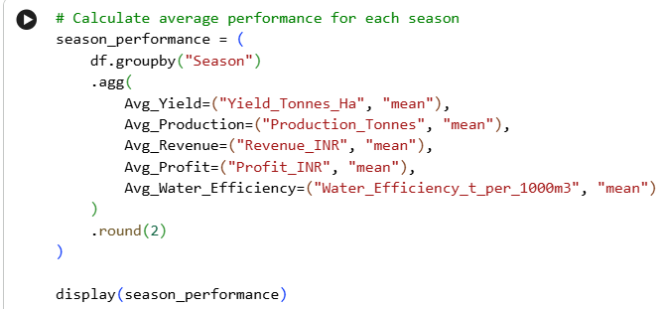
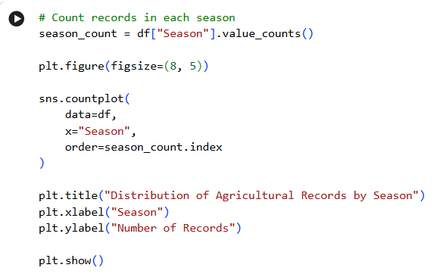
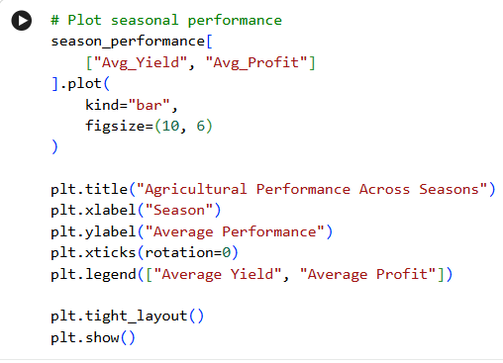
RESULTS (Code)

Slide 9
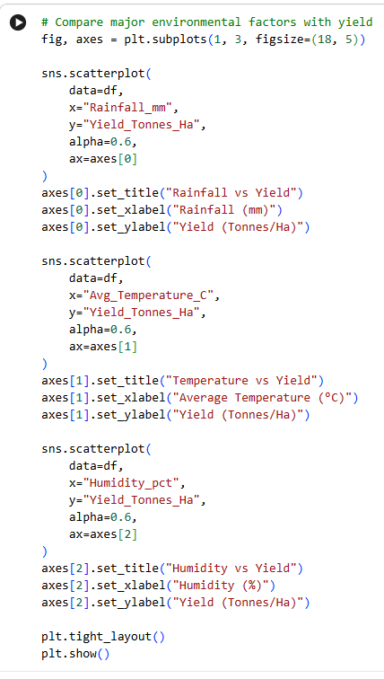
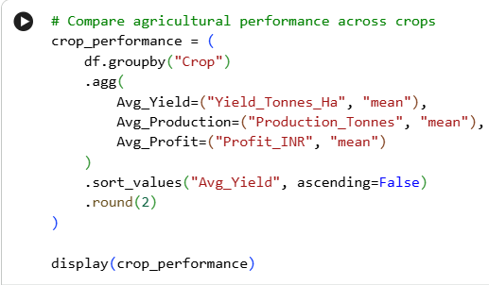
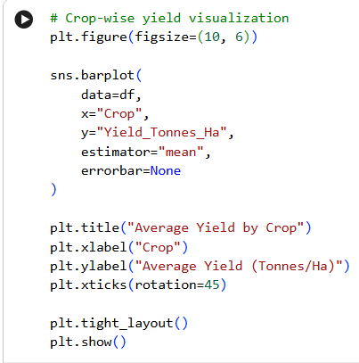
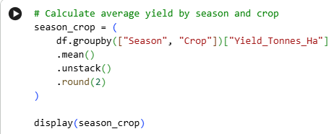
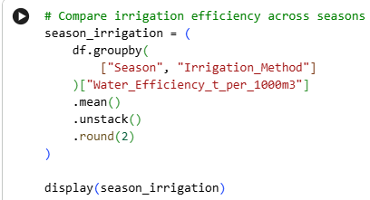
RESULTS (Code)

Slide 10
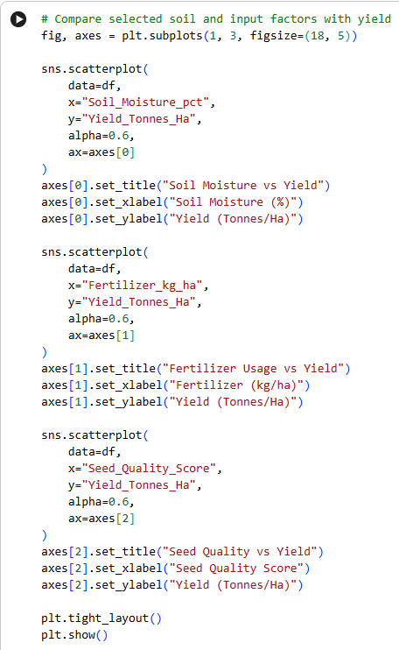
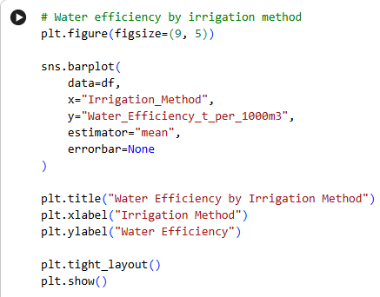
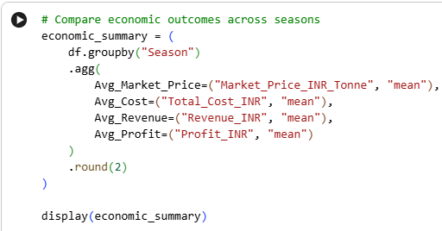
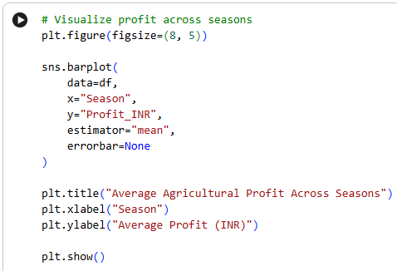
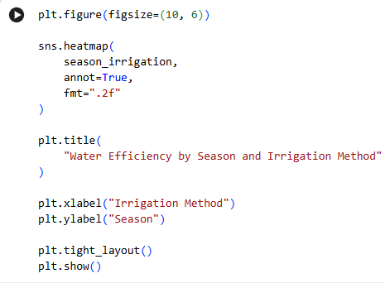
RESULTS (Code)

Slide 11
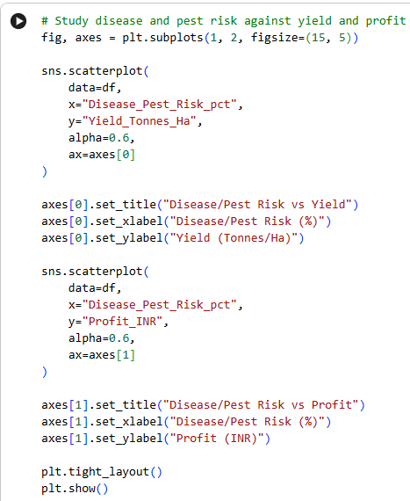
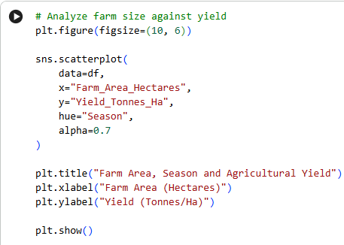
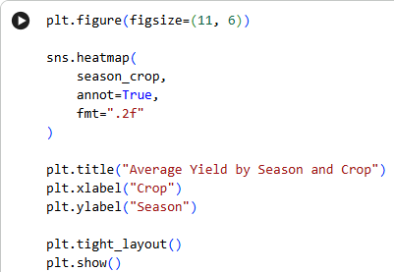
RESULTS (Code)

Slide 12
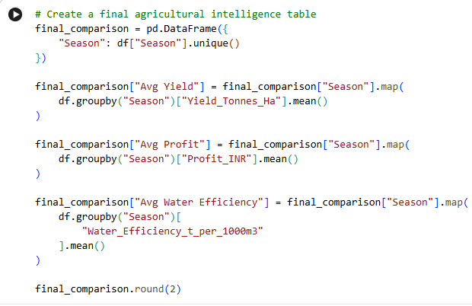
RESULTS (Code)

Slide 13
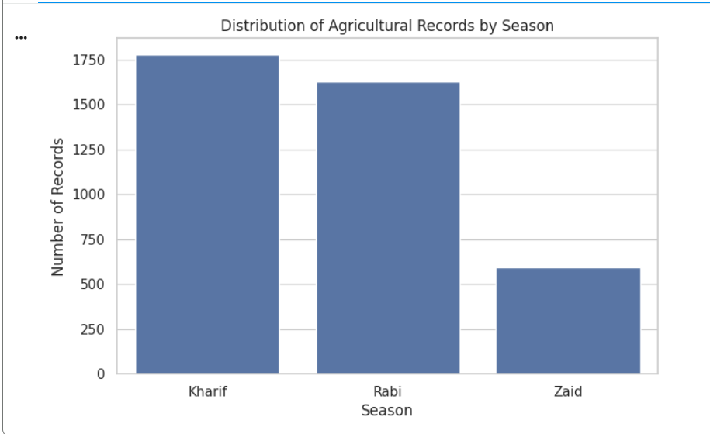
RESULTS
Shows how the agricultural records are distributed across seasons.

Slide 14
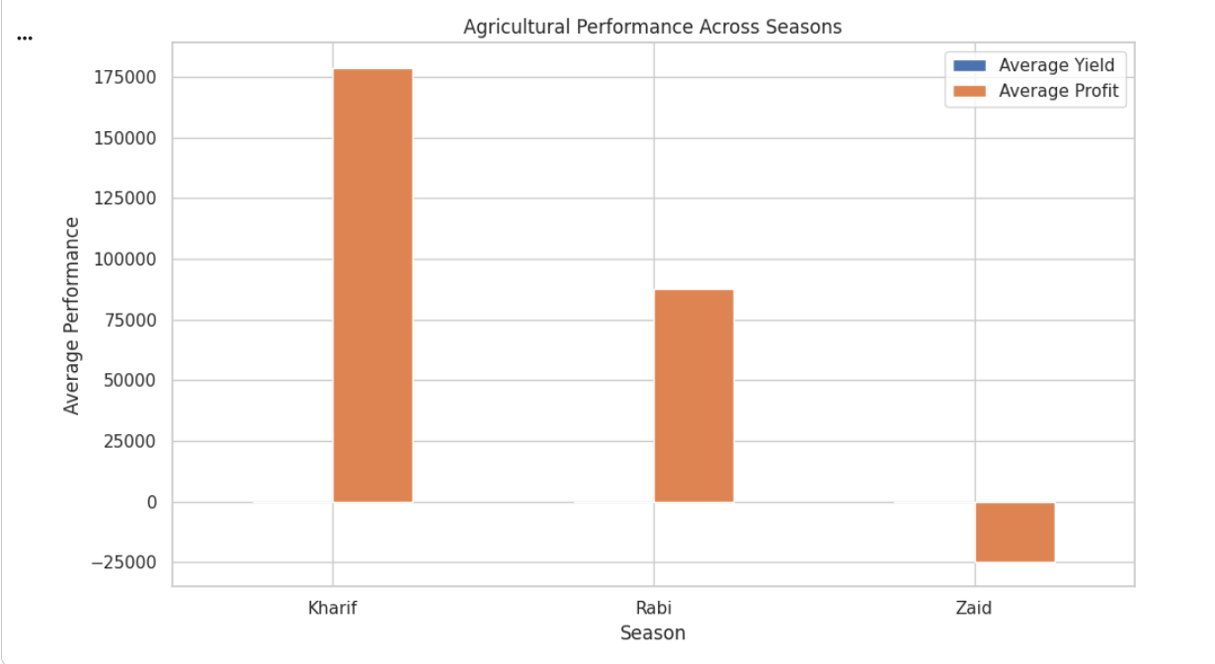
RESULTS
Compares yield and profitability across Kharif, Rabi and Zaid.

Slide 15
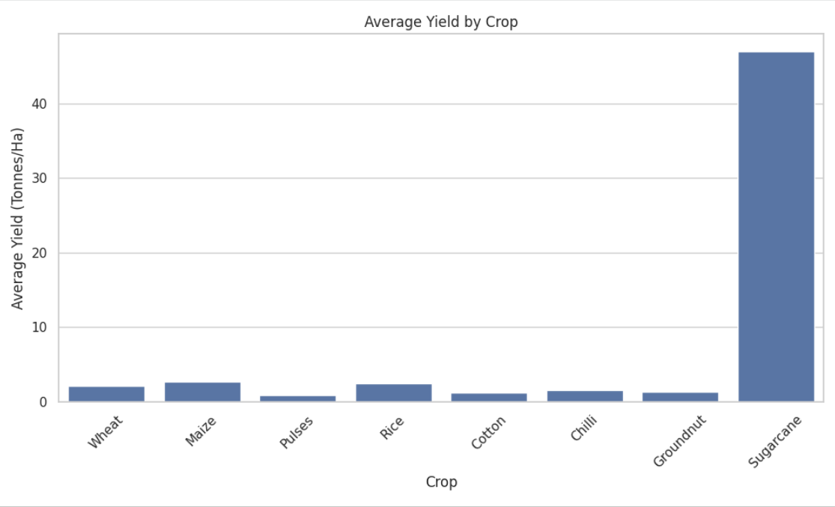
RESULTS
Identifies crops with higher and lower average yield.

Slide 16
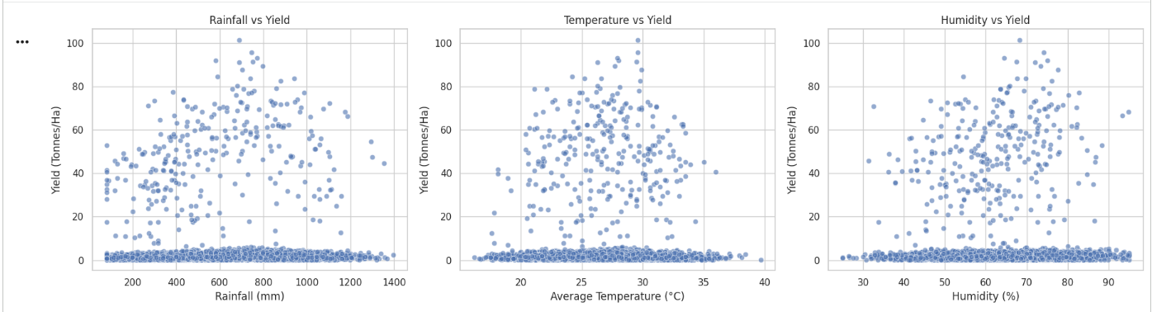
RESULTS
Examines how environmental conditions are associated with agricultural yield.

Slide 17
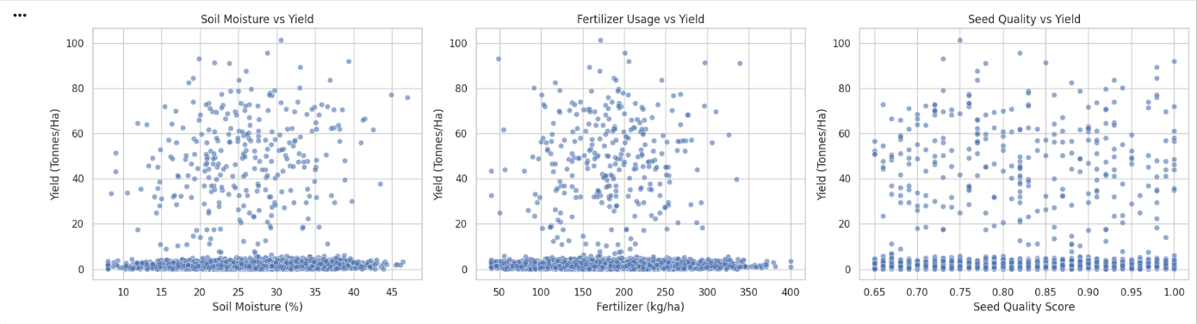
RESULTS
Studies the relationship between soil/input conditions and crop yield.

Slide 18
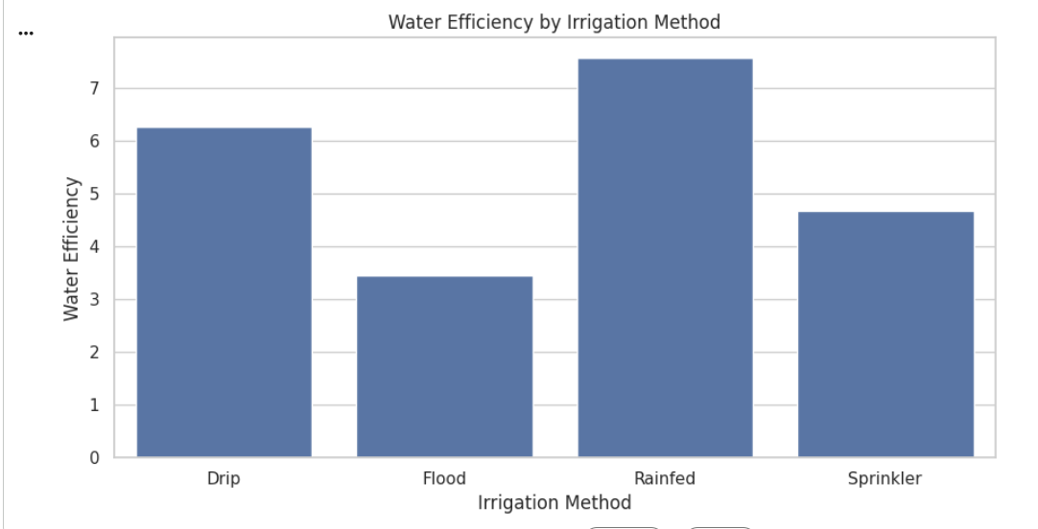
RESULTS
Compares irrigation methods based on water efficiency.

Slide 19
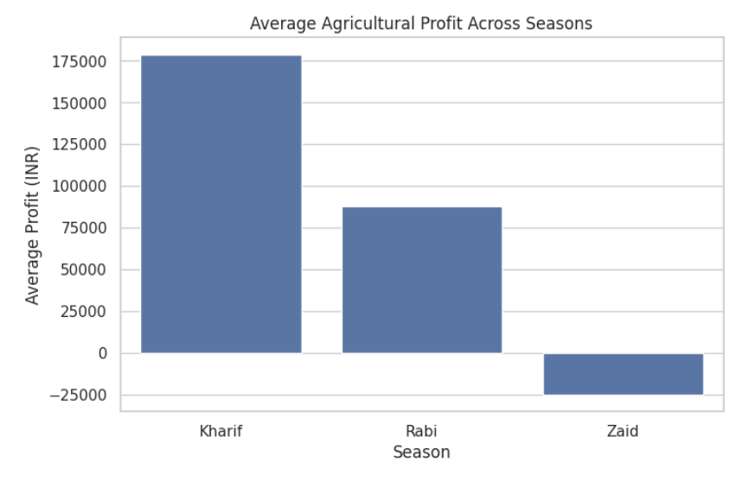
RESULTS
Shows how economic performance varies by season.

Slide 20
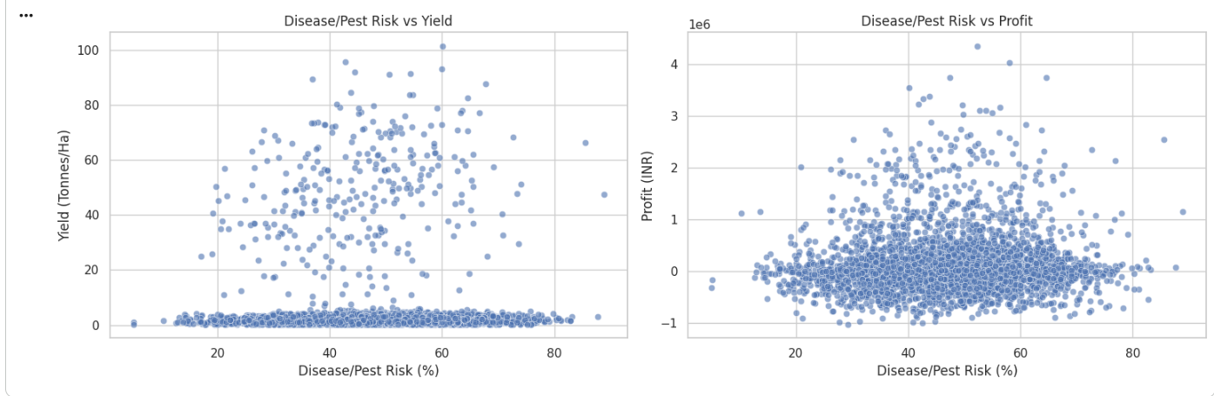
RESULTS
Examines whether agricultural risk levels are associated with yield and profit.

Slide 21
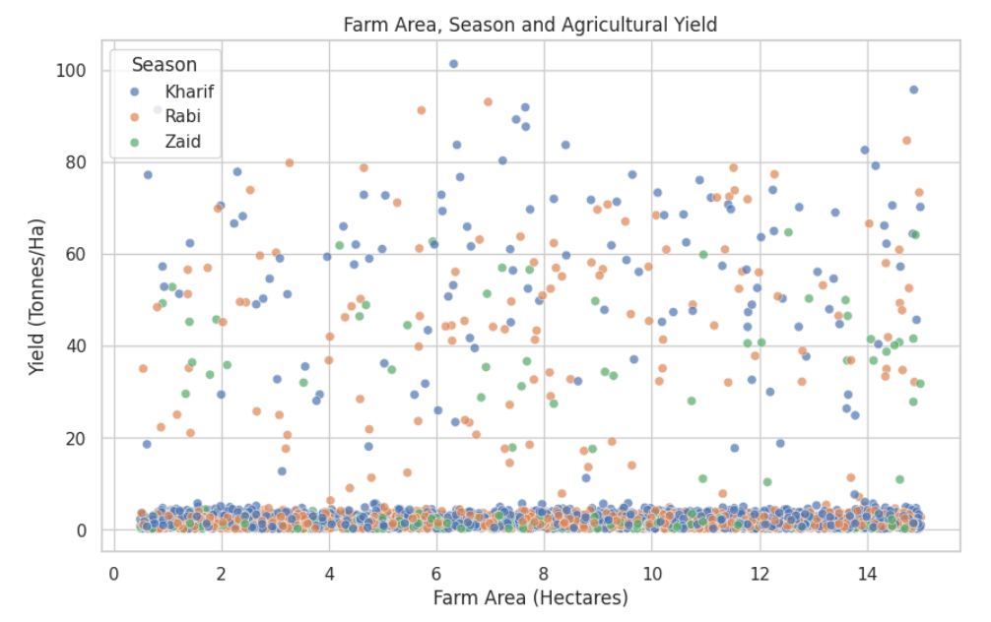
RESULTS
Examines whether farm area and seasonal conditions show different yield patterns.

Slide 22
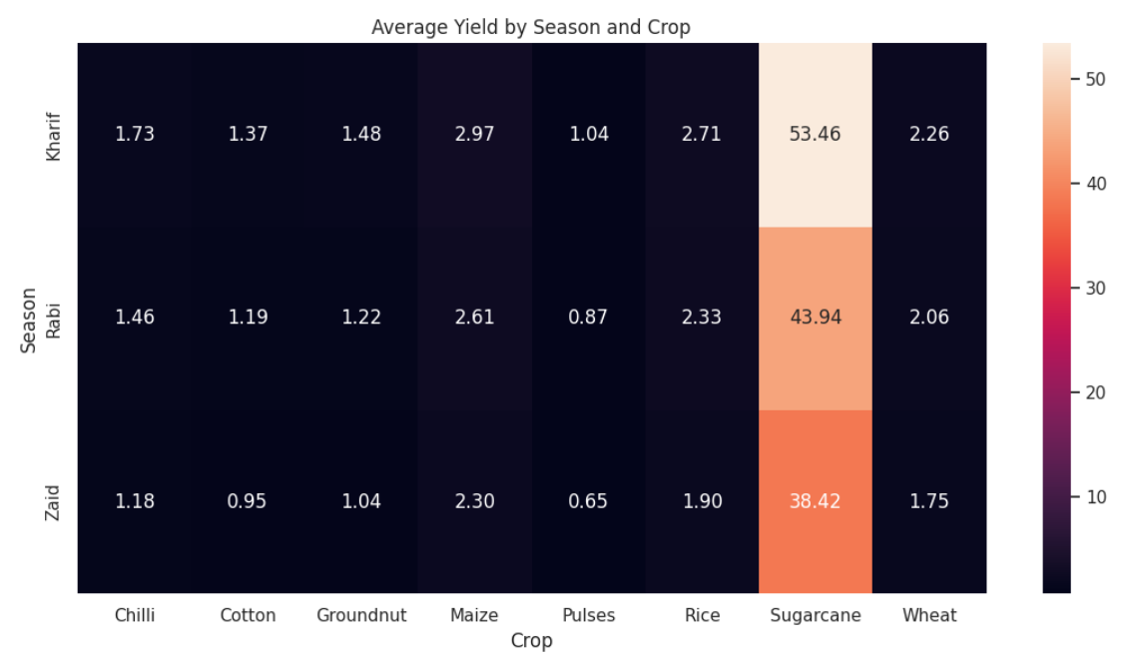
RESULTS
Shows which crop-season combinations have stronger observed yield.

Slide 23
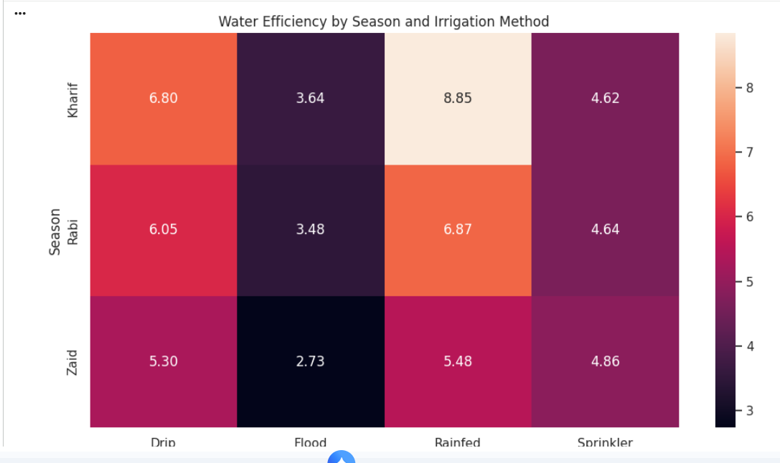
RESULTS
Identifies seasonal irrigation patterns and water-efficiency differences.

Slide 24
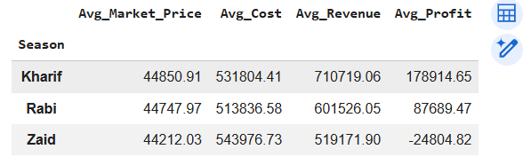
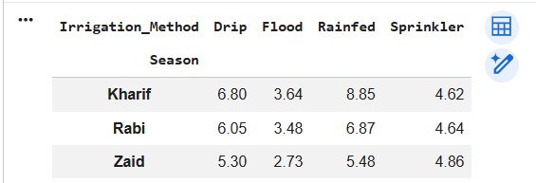
RESULTS

Slide 25
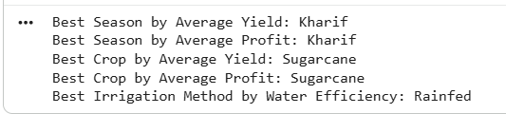
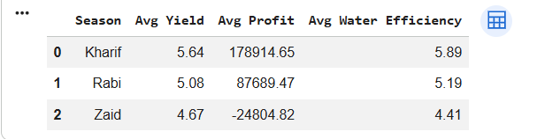
RESULTS
Produces the final evidence needed to identify the strongest seasonal agricultural performance.

Slide 26
FUTURE SCOPE
Predictive Yield Analysis – Develop machine learning models to predict crop yield under different seasonal conditions.
Crop Recommendation System – Recommend suitable crops based on soil, weather, season and resource conditions.
Weather-Based Decision Support – Integrate real-time weather data to improve seasonal farming decisions.
Smart Irrigation Optimization – Develop systems to recommend efficient irrigation methods and water usage.
Economic Forecasting – Predict future crop prices, revenue, costs and profitability using historical agricultural data.
Disease & Pest Prediction – Use environmental and crop conditions to identify and predict potential disease and pest risks.
Real-Time Agricultural Dashboard – Build an interactive dashboard for farmers and agricultural stakeholders to monitor seasonal performance and make data-driven decisions.

Slide 27
GITHUB LINK
https://github.com/Rifacspu2004/VOIS-Major-Project--Agriculture-Analysis
Use ctrl+click for link

Slide 28
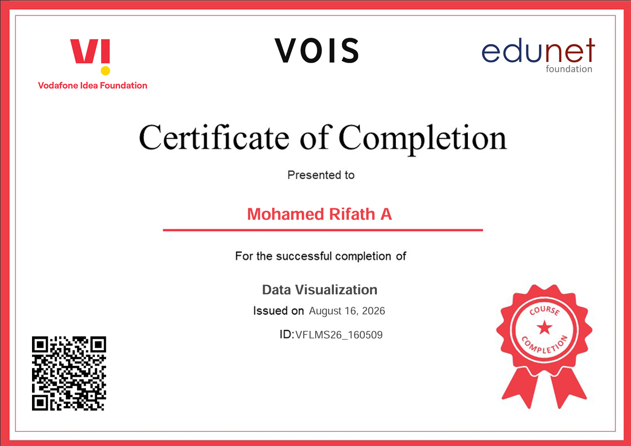
VOIS Course Completion Certificate – Data Visualization

Slide 29
Code Execution & Data Sets
Dataset: Seasonal_agriculture_performance_dataset.
Notebook: Jupyter Notebook / Google Colab
Programming: Python-based data cleaning, feature engineering and exploratory data analysis
Repository: https://github.com/Rifacspu2004/VOIS-Major-Project--Agriculture-Analysis
Project Files Include: Dataset • Executed Jupyter Notebook
• Analysis Code • Visualizations
Note: The notebook contains the complete execution workflow used to generate the analysis and visualizations presented in this project.
.
Use ctrl+click for link

Slide 30
References
Seasonal Agriculture Performance Dataset — dataset used for the VOIS AICTE Major Project analysis.
Python Documentation — programming language and analysis reference.
Pandas Documentation — data manipulation and exploratory analysis reference.
NumPy Documentation — numerical operations reference.
Matplotlib Documentation — plotting and visualization reference.
Seaborn Documentation — statistical visualization reference.
Jupyter Notebook / Google Colab — execution and documentation environment.
.
.

Slide 31
Conclusion
Seasonal Performance Comparison – Analysed how agricultural performance varies across Kharif, Rabi and Zaid seasons.
Crop Performance Analysis – Compared crop-wise yield, production and profitability to identify performance patterns.
Environmental Impact Analysis – Examined relationships between rainfall, temperature, humidity and crop yield.
Soil & Input Analysis – Studied the influence of soil conditions, fertilizer, pesticide and seed quality on agricultural outcomes.
Resource Efficiency Analysis – Compared irrigation methods, water usage and water efficiency across agricultural activities.
Economic & Risk Analysis – Evaluated market price, cost, revenue, profit and disease/pest risk to understand overall performance.
Data-Driven Insights – Identified meaningful seasonal patterns and relationships that can support better agricultural planning and resource management.
.
.

Slide 32
Thank You
.
.

